Slide 1
Managing Dependencies
Managing Dependencies can be more intricate than you might expect.
It involves:
Tracking all dependent objects for a given program
Directing the database on how to resolve changes to dependent objects.

Slide 2
What Triggers Invalidation?
Before you can effectively manage dependencies, you must understand the exact mechanism the database uses to conclude whether dependent objects have changed.
Did it use timestamp and signatures to determine whether the object is invalid?
Is this a single database or multiple remote databases within a distributed environment?

Slide 3
Local vs Distributed Databases
Local
The database uses dependency information stored in the data dictionary.
This may affect stored objects and objects already cached in the SGA memory.
Distributed Databases
Employs timestamp or signature dependency management.
Web-based application environments are very common distributed databases.

Slide 4

Timestamp Dependency Mgmt

Slide 5



Timestamp Dependency Mgmt
Database Server A
Remote Procedure Calls are made to the Database Server
Program A
Dependency 1
7/28/12
RPC
Dependency 2
4/12/11
Database Server B
Dependency 1
7/28/12
The datestamps for dependent objects match
Dependency 2
4/12/11

Slide 6


Timestamp Dependency Mgmt
Database Server A
When the RPC is made to the datestamps no longer match
Marked Invalid
Program A
Dependency 1
7/28/12
RPC
Dependency 2
4/12/11
Database Server B
Dependency 1
7/28/12
Dependency 2 is changed, therefore the timestamp changes
Dependency 2
5/2/13

Slide 7
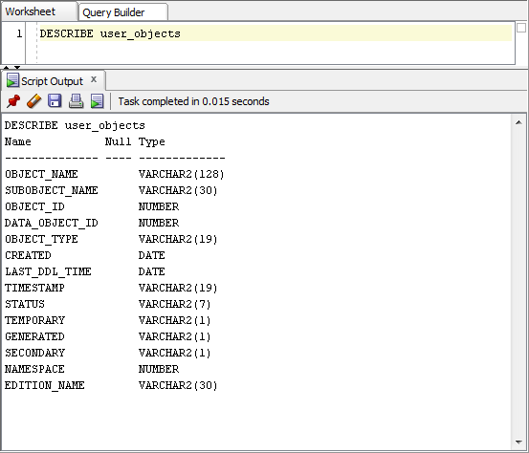
USER_OBJECTS View
The DESCRIBE View command tells Oracle to show the underlying view.
DESCRIBE user_objects

Slide 8
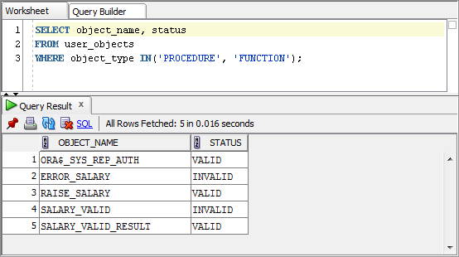
Query USER_OBJECTS
The following query, we limit the selection to stored procedures and functions.

Slide 9
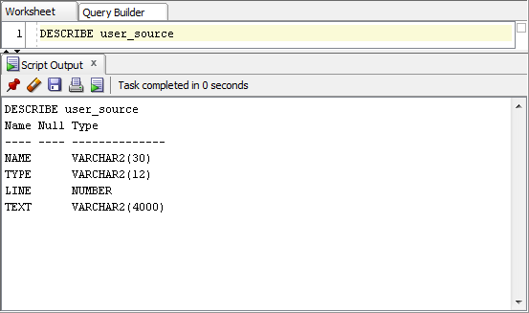
USER_SOURCE View
DESCRIBE user_source

Slide 10
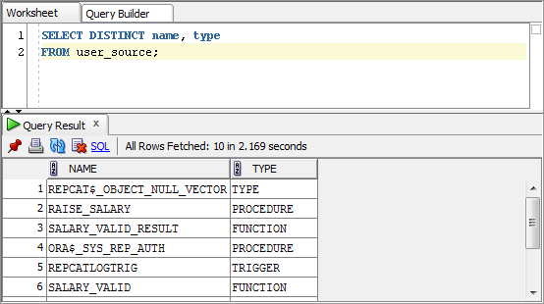
Query USER_SOURCE
The following query retrieves all objects that have source code.
The RAISE_SALARY procedure is currently stored in the database.

Slide 11
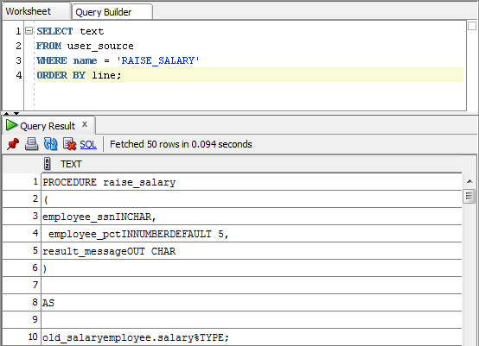
Query USER_SOURCE (cont)
Now that we know about the RAISE_SALARY procedure, we can retrieve the stored code.

Slide 12
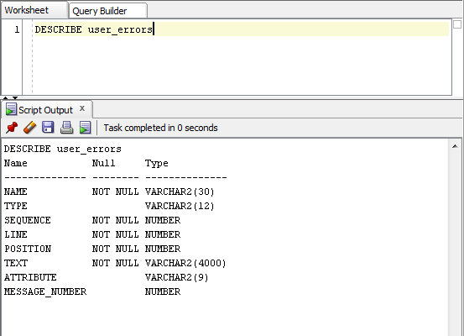
USER_ERRORS View
DESCRIBE user_errors
The ATTRIBUTE column contains the values ‘ERROR’ or ‘WARNING’ indicating the severity.

Slide 13
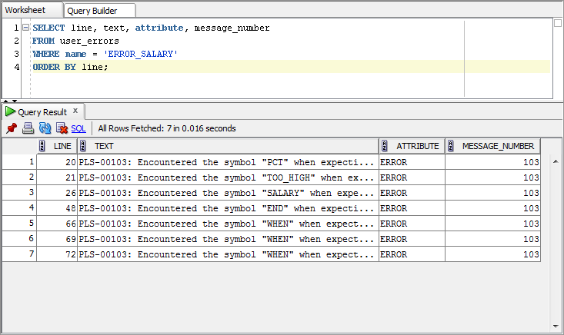
Query USER_ERRORS
We learned from our earlier query that the ERROR_SALARY procedure is invalid. We can query the view to see the errors.
SELECT line, text, attribute, message_number
FROM user_errors
WHERE name = 'ERROR_SALARY'
ORDER BY line;

Slide 14
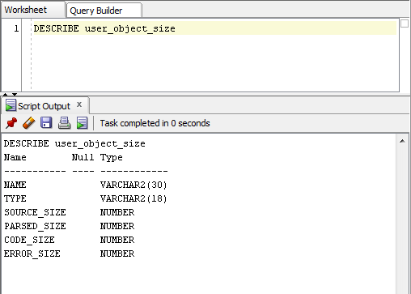
USER_OBJECT_SIZE View
The USER_OBJECT_SIZE is instrumental in planning for the storage and execution of PL/SQL applications within the database.
DESCRIBE user_object_size

Slide 15
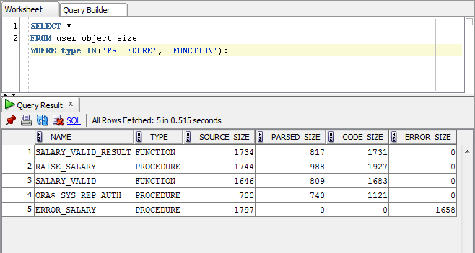
Query USER_OBJECT_SIZE
Each of the columns describe a different size parameter for the objects.

Slide 16
USER_OBJECT_SIZE Columns
Column | Explanation
SOURCE_SIZE | Indicates the size of the source code.
PARSED_SIZE | This is the parsed form of the program which is loaded into memory during compilation. The maximum size is 64K.
CODE_SIZE | This is the compiled version of the program. There is a maximum size of 128K.
ERROR_SIZE | This is the size of the error message information, if any.

Slide 17
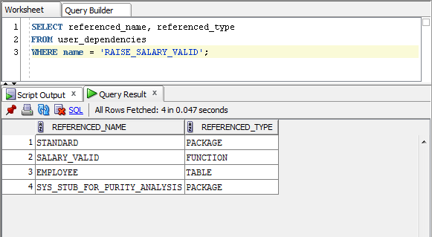
Using USER_DEPENDENCIES
This view exposes limited dependency information pertaining to program objects.
 The name is case sensitive
 This view is somewhat limited because it only reveals a single-level of direct dependencies.

Slide 18

See it in Action

